Slide 1

Unit No:2
Transistors and their Applications:
DR SHIVANI SHARMA

Slide 2

MODULE 2
Unit II: Transistors and their Applications
BJT: Construction & Working Principle of Bipolar Junction Transistor, Common Base, Common Emitter and Common Collector Configurations and their characteristics, BJT as a switch FET: Comparison of BJT & FET; Construction, Working Principle and Characteristics of JFET & MOSFET (Enhancement and Depletion), Concept of pinch-off, FET as a voltage variable resistor and a constant current source CMOS: Construction, Working Principle and Characteristics of CMOS. NOT, NAND & NOR implementation using CMOS

Slide 3
Need for Transistors:
The term "transistor" is derived from the combination of two words: "transfer" and "resistor." The name reflects the primary function of a transistor, which is to transfer an electrical signal (amplify or switch) while acting as a resistor to control the flow of current.
“Transistor” (Transfer +resistor).Before the invention of transistors, electronic amplification and switching were primarily achieved using vacuum tubes. However, vacuum tubes had several limitations, including large size, high power consumption, and the tendency to generate significant heat. The need for a more compact, efficient, and reliable alternative led to the development of transistors.

Slide 4
Amplification:
  Audio Amplifiers: Transistors are widely used in audio amplifiers to boost the strength of weak audio signals, making them suitable for driving speakers.
  Radio Frequency (RF) Amplifiers: In communication systems, transistors amplify radio frequency signals before transmission or reception.
Switching:
  Digital Logic Gates: Transistors are the building blocks of digital circuits, forming the basis of logic gates (AND, OR, NOT, etc.) used in computers, microcontrollers, and other digital devices.
  Microprocessor and Integrated Circuits: Transistors are crucial components in the design of microprocessors and other integrated circuits, enabling the processing and control of digital signals.
Signal Modulation
Voltage Regulation
Power Amplification
Light Emitting Diodes (LEDs) Driving
Sensors

Slide 5
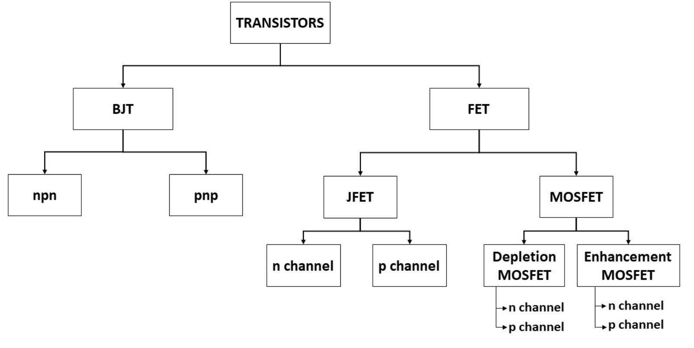
Classification of Transistor

Slide 6
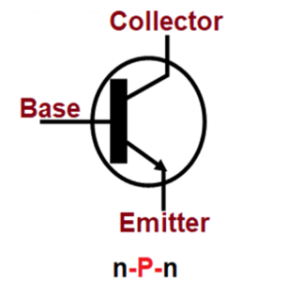
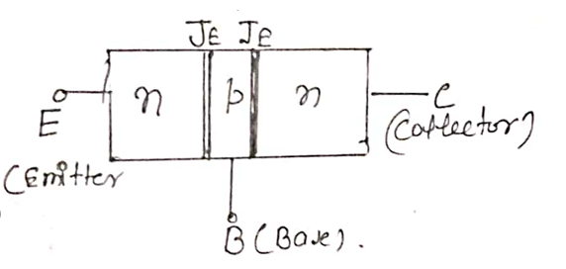
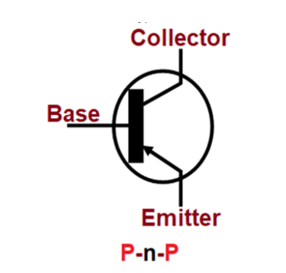
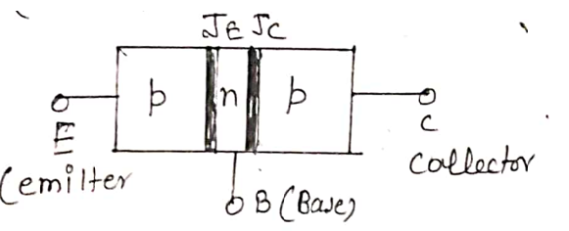
Construction of Transistor
n-p-n
p-n-p

Slide 7
Emitter: The emitter is one of the three layers in a BJT. It is heavily doped with either P-type or N-type material, depending on whether the transistor is PNP or NPN.
In an NPN transistor, the emitter is made of N-type material (negatively doped), while in a PNP transistor, it is made of P-type material (positively doped).
The emitter is the source of charge carriers (electrons in NPN or holes in PNP) that flow into the base region.

Slide 8
Base:
The base is the middle layer of the transistor and is lightly doped. It separates the emitter from the collector.
So most of the carrier coming from emitter passes to collector.
The base controls the flow of charge carriers from the emitter to the collector. By applying a small input current to the base, the larger output current between the collector and emitter can be controlled, leading to amplification.

Slide 9
Collector:
The collector is the layer on the opposite side of the base from the emitter. It is typically larger and more heavily doped than the base but less than emitter.
The collector collects the majority of charge carriers (electrons in NPN or holes in PNP) that pass through the base-emitter junction. The collected carriers form the output current.
Area profile: C > E > B
Doping profile: E > C > B

Slide 10
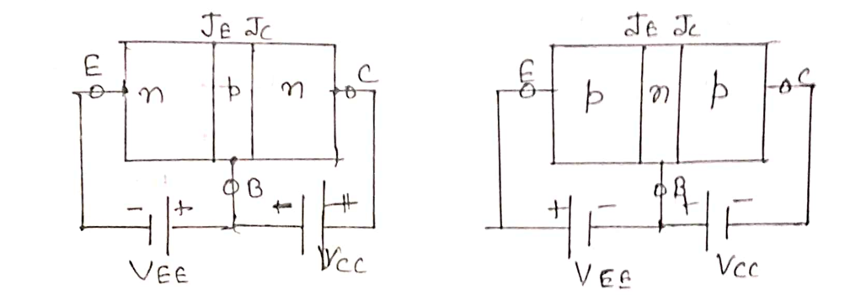
Mode or Working Regions of Transistor
Transistor operates in three modes:
i) Active region:
In active region emitter-base junction (J_{E}) is forward biased and collector -base junction (J_{C}) is reverse biased. In this region transistor works as an amplifier.

Slide 11
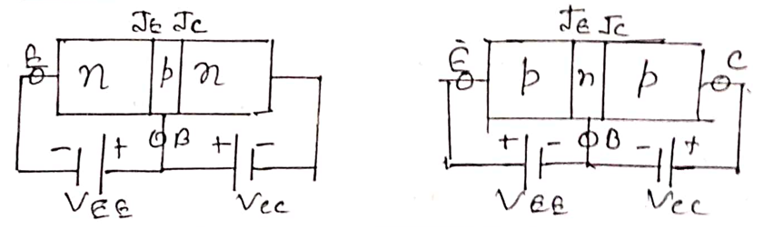
ii) Saturation region:
In this region emitter-base junction (J_{E}) and collector -base junction (J_{C}) are forward biased. In this region transistor works as a closed switch.

Slide 12
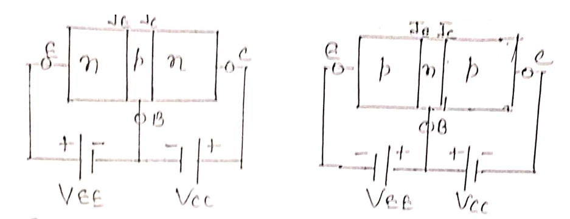
iii) Cut-off region:
In this region emitter-base junction (J_{E}) and collector -base junction (J_{C}) are reverse biased. In this region transistor works as a open switch.

Slide 13
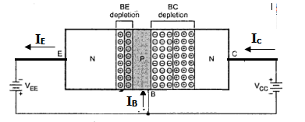
Operation of Transistor in Active Region
To operate BJT in active region J_{EB} (emitter base junction) must be forward biased and J_{CB} (collector base junction) must be reverse biased.

Slide 14
Operation of Transistor in Active Region
J_{EB} is forward biased by the battery V_{EE} by which the depletion region will decrease and a majority carrier flow will occur from emitter to base giving current I_{majority} or I_{E}.
So, Here, I_{eE} is current due to electrons of emitter region and I_{hB} is current due to holes in base region.

Slide 15
Operation of Transistor in Active Region
In base region there is recombination between electrons and holes due to which base current is obtained. As number of holes in base is very small, base current is very small.
J_{CB} is reverse biased by V_{CC}. So collector current is due to flow of minority charge carriers from both sides of the junction. In base minority carriers are electrons left after recombination and in collector minority carriers are holes. So,
Directions of all terminal currents are shown in figure and it is clear that,

Slide 16
Operation of Transistor in Active Region
Directions of all terminal currents are shown in figure and it is clear that,

Slide 17
Transistor Configuration or Connection
Transistor has three terminals emitter, base and collector. But we require four terminals to connect the transistor in a circuit as an amplifier. Two for input and two for output.
This is achieved by making one terminal of transistor common to input and output.
So, transistor has three configurations based on the common terminal.
Common base configuration (CB)
Common emitter configuration (CE)
Common collector configuration (CC)

Slide 18
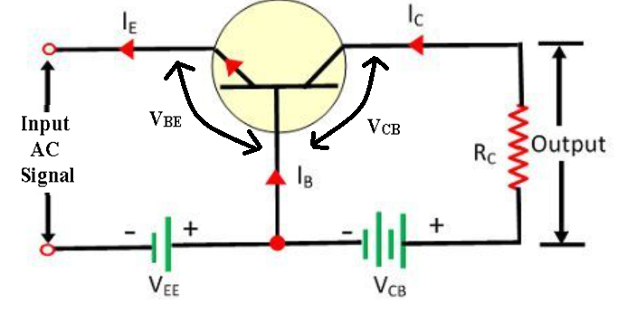
Common base configuration (CB)
Input is applied between emitter and base
Output is taken out from collector and base
Base is common between input and output.

Slide 19
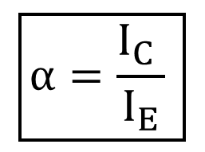
DC Current gain:
It is the ratio of output current (I_{C}) to the input current (I_{E}).
$$\boxed{α=\frac{I_{C} }{I_{E}} }$$
Since I_{E} > I_{C} so value of α is less than 1
Value of α ranges from .90 to .99
So, no current gain is available in CB configuration.

Slide 20
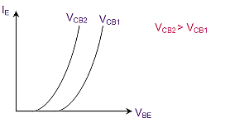
Input V/I Characteristics of CB Configuration
By keeping constant V_{CB}, when forward bias at emitter base junction is increased then graph between I_{B} and V_{EB} is similar to forward characteristics of pn junction diode. If this graph is again drawn for some higher value of V_{CB­} a similar graph is obtained with reduced knee voltage.

Slide 21
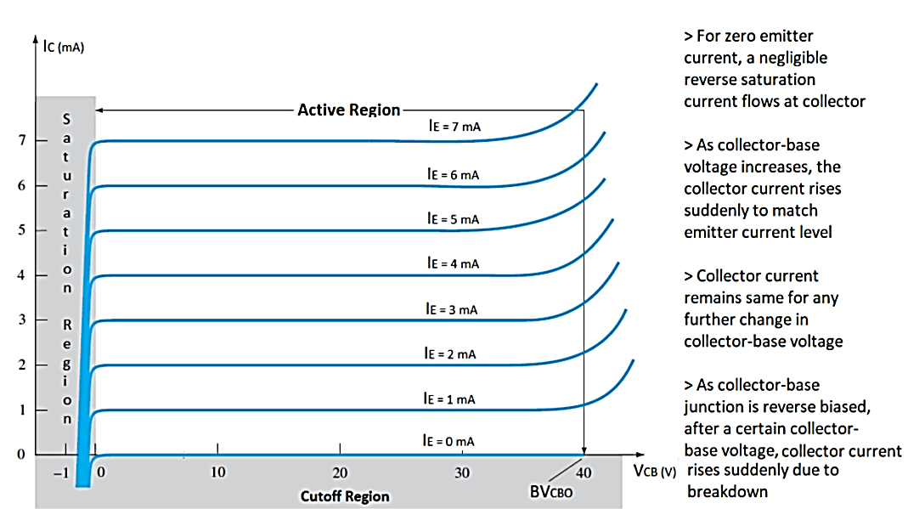
Output V/I Characteristics of CB Configuration

Slide 22
Characteristics of CB Configuration
Active Region: For given α and I_{E,} I_{C} is dependent only on I₀ which is slightly dependent on V_{CB}. So, graph of active region is almost independent of V_{CB}.
Saturation Region: When the transistor is switched from active to saturation region, a large change in collector current for very small forward bias voltage at collector to base junction is obtained in negative direction.
Cut-Off Region: When both the junctions are reverse biased, a very small collector current is obtained which is close to horizontal axis.

Slide 23
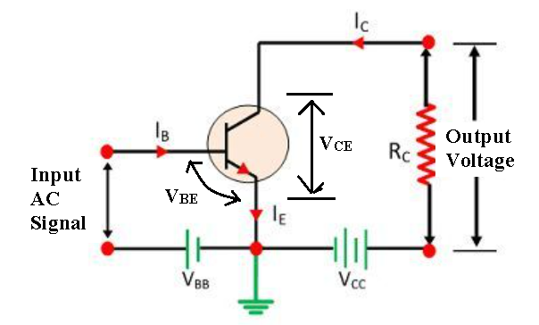
Common Emitter Configuration (CE)
In this configuration input is applied between base and emitter while output is taken out from collector and emitter. So, emitter of transistor is common to both input and output.

Slide 24
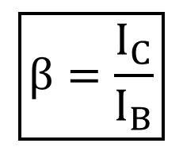
DC Current gain:
It is the ratio of output current (I_{C}) to the input current (I_{B}).
$$\boxed{β=\frac{I_{C}}{I_{B}}}$$
Since value of I_{B} << I_{C}. So β >>1. Therefore, current gain is available in CE configuration
Value of β varies from 20 to 500.

Slide 25
Input V/I Characteristics of CE Configuration
It is graph between input current (I_{B}) and input voltage (V_{BE}) at constant output voltage (V­_{CE}). This graph is drawn for active region of BJT.
By keeping constant V_{CE}, when forward bias at emitter base junction is increased then graph between I_{E} and V_{BE} is similar to forward characteristics of pn junction diode.

Slide 26
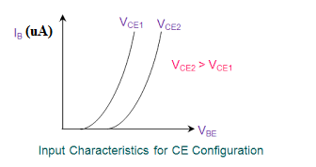
Input V/I Characteristics of CE Configuration

Slide 27
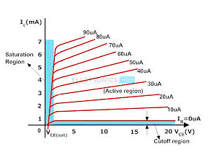
Output V/I Characteristics of CE Configuration

Slide 28
Output V/I Characteristics of CE Configuration
Active Region: For given β and I_{B,} I_{C} is dependent on (β +1)I₀ which is more dependent on V_{CE} than in case of CB configuration. So, graph of active region has some slope showing change in I_{C} on changing V_{CE.}
Saturation region: When the transistor is switched from active to saturation region, a large change in collector current for very small change in collector voltage is obtained in negative direction.
Cut-Off Region: When both the junctions are reverse biased, a very small collector current is obtained which is close to horizontal axis.

Slide 29


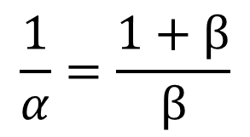
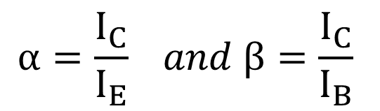
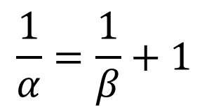
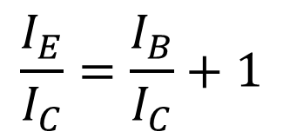
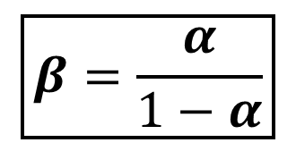
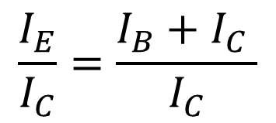

Relation between α and β
$$α=\frac{I_{C}}{I_{E}} and β=\frac{I_{C}}{I_{B}}$$
$$\frac{1}{α}=\frac{1}{β}+1$$
$$I_{E}=I_{B}+I_{C}$$
$$\frac{1}{α}=\frac{1+β}{β}$$
Dividing both sides by I_{C}
$$\frac{I_{E}}{I_{C}}=\frac{I_{B}+I_{C} }{I_{C}}$$
$$α+αβ=β$$
$$β\left(1−α\right)=α$$
$$\frac{I_{E}}{I_{C}}=\frac{I_{B}}{I_{C}}+1$$
$$\boxed{β=\frac{α}{1−α}}$$

Slide 30
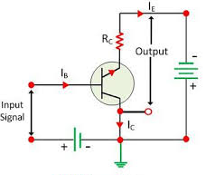
Common Collector Configuration
In this configuration we use collector terminal as common for both input and output signals. This configuration is also known as emitter follower configuration because the emitter voltage follows the base voltage. This configuration is mostly used as a buffer. These configurations are widely used in impedance matching applications because of their high input impedance. In this configuration the input signal is applied between the base-collector region and the output is taken from the emitter-collector region. Here the input parameters are VBC and IB and the output parameters are VEC and IE.
ϒ = I_{E} / I_{B}
Sometimes common collector configuration is also referred to as emitter follower, voltage follower, common collector amplifier, CC amplifier, or CC configuration. This configuration is mostly used as a voltage buffer.

Slide 31
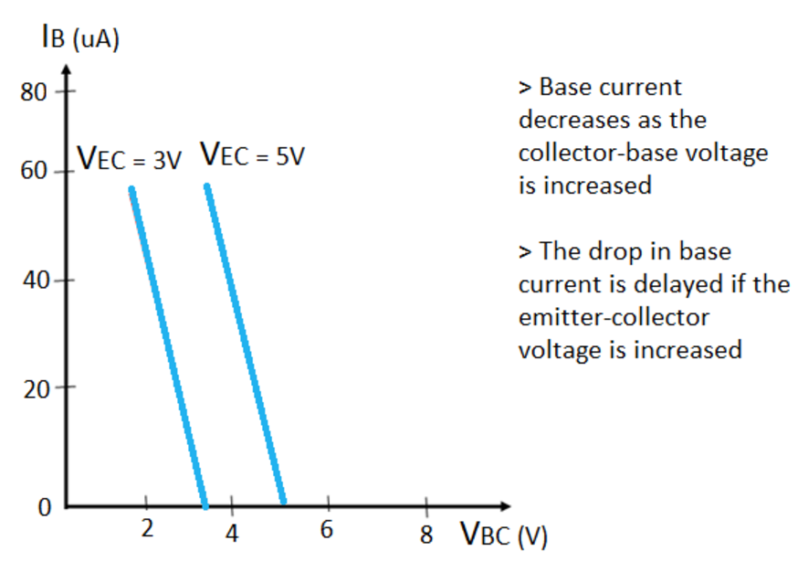
Input Characteristics
The input characteristics of a common-collector configuration are obtained between inputs current I_{B} and the input voltage V_{BC} at constant output voltage V_{CE} . Keep the output voltage V_{CE} constant at different levels and vary the input voltage V_{BC} for different points and record the I_{B} values for each point.
In a CC configuration, the input characteristics are obtained from the input base current and input common base voltage at a constant output emitter-collector voltage. To determine the input characteristics, the base-collector voltage is increased in equal steps while keeping the VCE at a fixed value. The corresponding increase in Ib is noted and plotted against the different values of VCE
Input parameters are V_{BC} and I_{B} and the output parameters are V_{CE} and I_{E}. Normally used for impedance matching or buffer

Slide 32
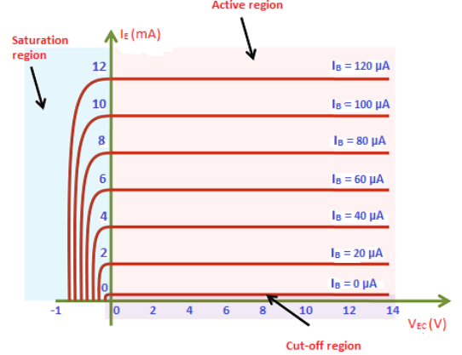
Output Characteristics
The operation of the common collector circuit is same as that of common emitter circuit. The output characteristics of a common collector circuit are obtained between the output voltage V_{CE} and output current I_{E} at constant input current IB. In the operation of common collector circuit if the base current is zero then the emitter current also becomes zero. As a result, no current flows through the transistor

Slide 33
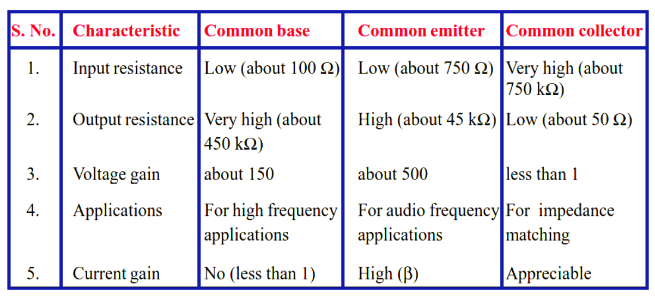
Comparison of Transistor Configuration or Connections

Slide 34
Common emitter (CE): Has both voltage and current gain, and is commonly used for amplification.
Common base (CB): Has voltage gain but no current gain, and is suitable for impedance matching and RF amplifier circuits.
Common collector (CC): Has current gain but no voltage gain, and is commonly used for impedance buffering and voltage amplification.
WHY IS BJT CALLED CURRENT CONTROLLED DEVICE?
A bipolar junction transistor (BJT) is called a current-controlled device because the output current of a BJT is dependent on the input current. The base current controls the collector current, and the output characteristics of a BJT are dependent on the base current.
A device is considered current-controlled if it turns on and off based on the current flowing through it. A BJT is a bipolar device, meaning that it conducts current through both majority and minority electrons and holes.

Slide 35
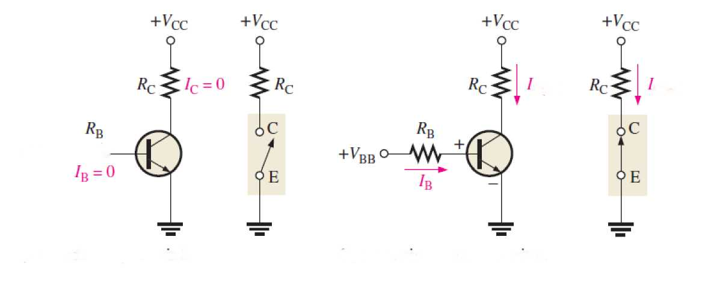
The BJT as a Switch
The major application for a BJT is a switching application. When used as an electronic switch, a BJT is normally operated alternately in cutoff and saturation.
Many digital circuits use the BJT as a switch, where 0 V means logic 0 (cutoff = open CCT. ) and +5 V means logic 1 (saturation = short CCT.).

Slide 36
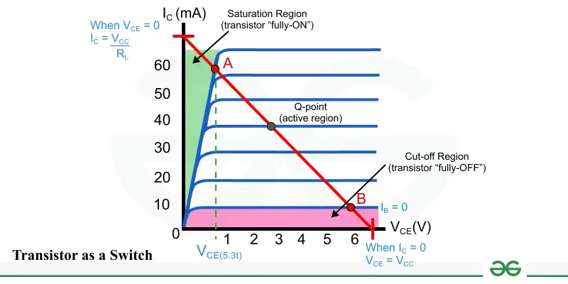

Slide 37
A BJT acts as a switch by operating in cutoff (off) and saturation (on) regions, controlled by its base current. In the cutoff region, no base current is applied, halting collector current flow, which is like an open switch. In the saturation region, sufficient base current is applied to allow maximum collector current flow, acting like a closed switch.
BJT Switch Operation Modes
Cutoff Region (Off): No or very little base current (I_B = 0) is applied to the base. The emitter-base junction is non-conducting, preventing current flow between collector and emitter.
The transistor is like an open circuit switch, blocking the flow of current through the load in the collector-emitter path.
2. Saturation Region (On): A sufficient amount of base current (I_B) is applied, exceeding a certain threshold. The emitter-base junction becomes forward-biased, and a large collector current (I_C) flows. The collector-emitter voltage (V_CE) drops to a very low value, close to zero.
The transistor acts as a closed switch, allowing maximum current to flow through the load.

Slide 39
Field Effect Transistor
  Introduction to Field Effect Transistors:
  Field-Effect Transistor (FET) is a semiconductor device that consists of a channel made of a semiconductor material, with two electrodes connected at either end, namely the drain and the source. The flow of current between the source and the drain terminals is controlled by a third electrode, known as the gate, which is placed in close proximity to the channel.
FETs have three terminals:
The first terminal is the source (S), through which current enters the device, denoted by IS.
  The second terminal is the drain (D), through which current leaves the device, denoted by ID. The voltage between drain and source is VDS.
  The third terminal is the gate (G), which modulates the channel conductivity. By applying a voltage at the gate, ID can be controlled

Slide 40
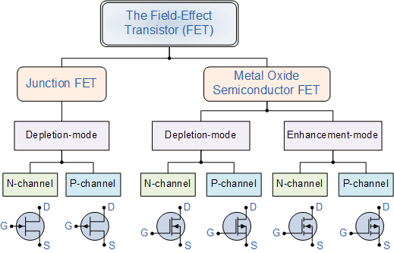
Classification of Transistor

Slide 41
Difference between BJT and FET
Feature | FET (Field Effect Transistor) | BJT (Bipolar Junction Transistor)
Type of Device | Voltage-controlled device | Current-controlled device
Operation Principle | Uses an electric field to control current | Uses input current to control the output current
Input Impedance | High (due to gate insulation) | Low
Output Impedance | Low | High
Current Flow | Majority carriers (unipolar) | Both majority and minority carriers (bipolar)
Speed | Generally faster due to high input impedance | Slower compared to FETs
Power Consumption | Low (requires less input current) | High (requires significant base current)
Thermal Stability | High (less prone to thermal runaway) | Low (prone to thermal runaway without proper compensation)
Noise Level | Low (better for high-frequency applications) | Higher (more noise compared to FETs)
Applications | Used in analog switches, amplifiers, and digital circuits | Used in power amplifiers, oscillators, and analog circuits

Slide 42
  Advantages of FET over BJT
BJT has two principle disadvantage
It has low input impedance due to Forward biased emitter junction.
It has considerable noise level.
The above problem are overcome by:
FET has large input impedance by virtue of its construction and biasing.
FET is generally much less noisy than BJT
  Advantages of FET over BJT
High input impedance (Linear AC amplifier system)
Temperature stable than BJT
Smaller than BJT
Can be fabricated with fewer processing
Usually use as logic switch

Slide 43
  Field Effect Transistor Construction & Types
A JFET consists of a thin bar of semiconductor material, which can be silicon or gallium arsenide. Regardless of whether it is an N-channel or P-channel JFET, the construction principles are similar:
Semiconductor Bar: A bar of semiconductor material (N-type for N-channel and P-type for P-channel) forms the core structure.
P-N Junctions: Two small regions of the opposite type (P-type for N-channel and N-type for P-channel) are diffused into the bar to create PN junctions.
Gate Terminal: The two diffused regions are internally connected to form the gate terminal, creating a single control point for the device.
Ohmic Contacts: The ends of the semiconductor bar form ohmic contacts with the source and drain terminals, ensuring efficient current flow.

Slide 44
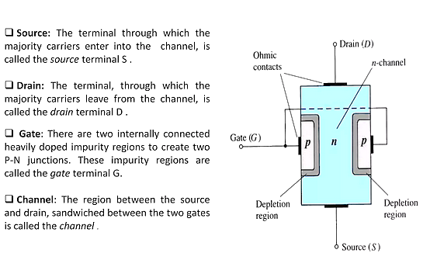
JFET( Junction Field Effect Transistor)

Slide 45
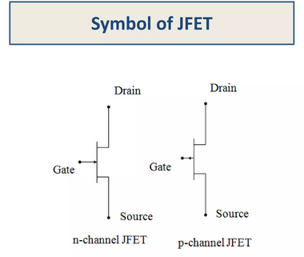
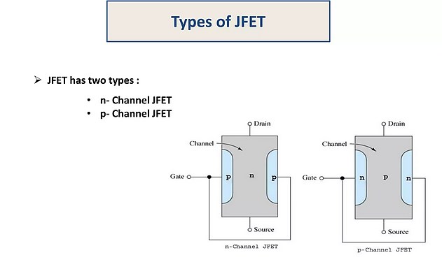
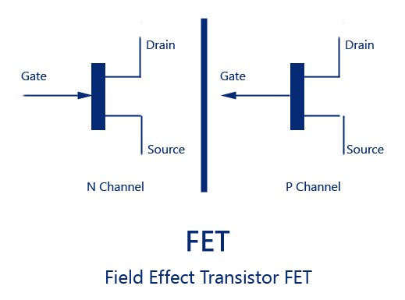
Construction of FET

Slide 46
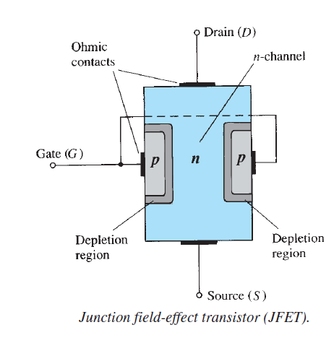
N- Channel JFET( Junction Field Effect Transistor)
Major structure is n-type material (channel) between embedded p-type material to form 2 p-n junctions. In the normal operation of an n-channel device, the Drain (D) is positive with respect to the Source (S). Current flows into the Drain (D), through the channel, and out of the Source (S). Electrons injected to Source (S) through p-type channel and flowed to Drain (D). I_{D} increases for positive V_{GS.}
On both side of base two heavily doped p regions are formed.
So, two p-n junction is formed which are internally connected by a gate terminal. Other two terminal are drain and source.

Slide 47
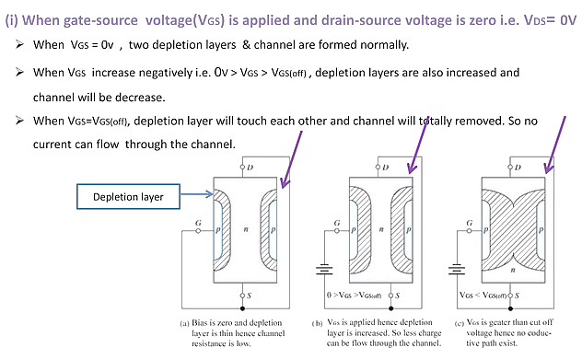

Slide 48
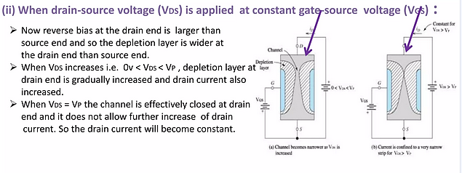

Slide 49

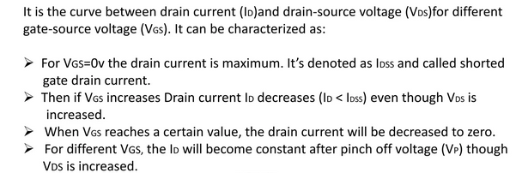
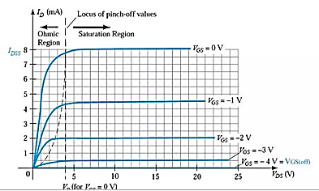

Slide 50

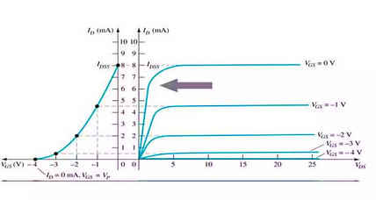

Slide 51
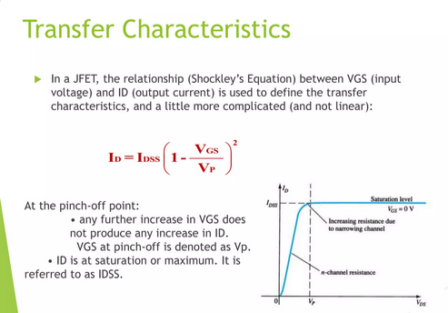

Slide 52
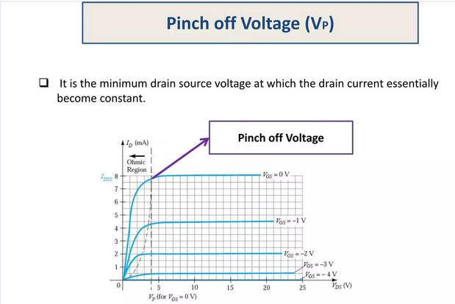

Slide 53
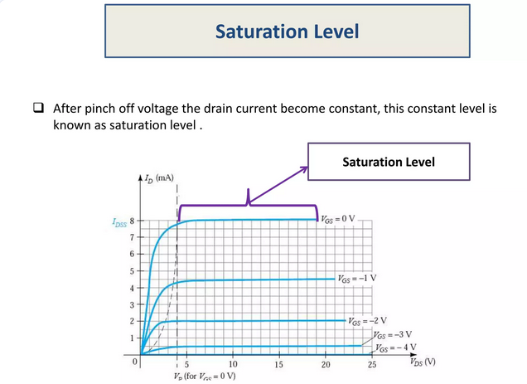

Slide 54
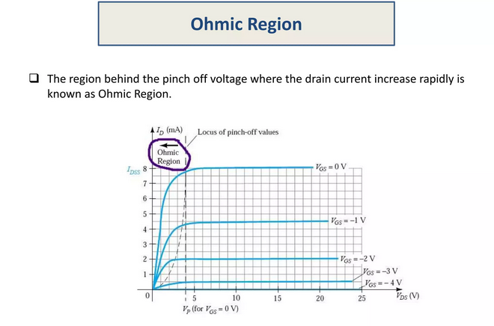

Slide 55
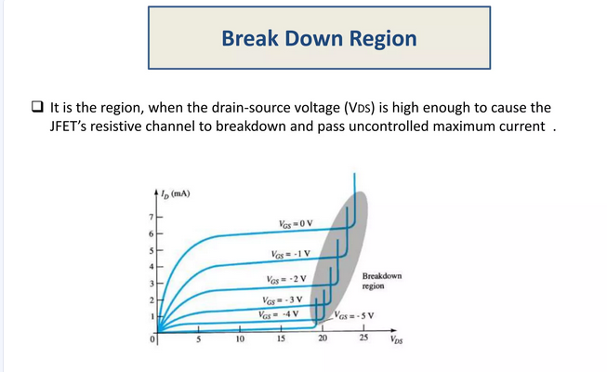

Slide 56
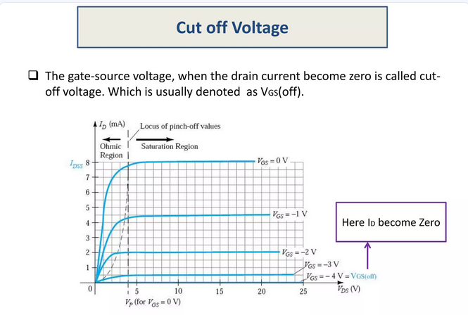

Slide 57
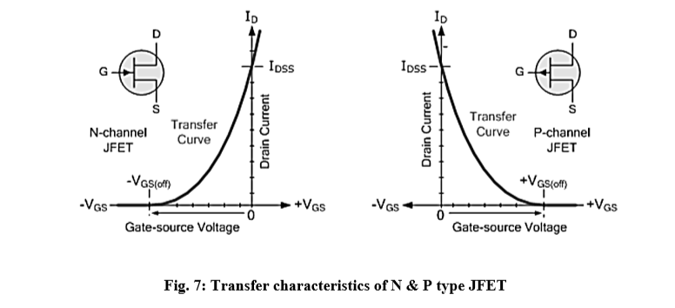

Slide 58
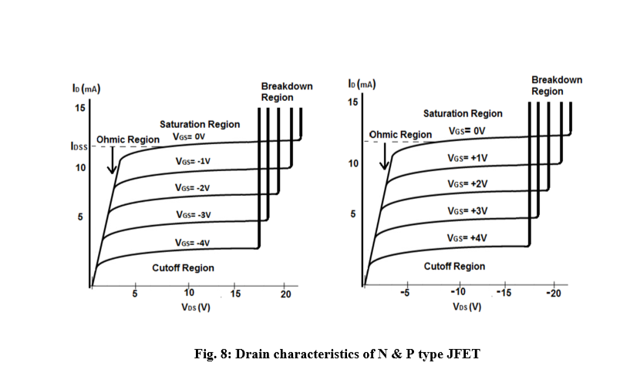

Slide 59
MOSFET (Types)
MOSFET: Metal-Oxide-Semiconductor Field Effect Transistor
Voltage-controlled device
Two main types: Enhancement (E-type) and Depletion (D-type)
Four types:
  n-channel enhancement mode
      Most common since it is cheapest to manufacture
  p-channel enhancement mode
  n-channel depletion mode
  p-channel depletion mode

Slide 60
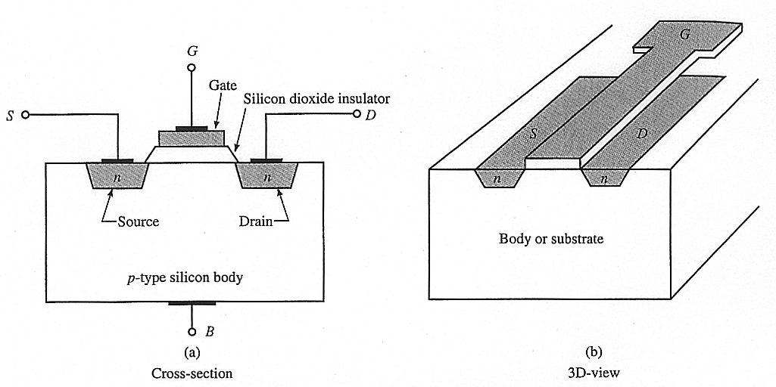
MOSFETCONSTRUCTION
MOSFET
Symbols of MOSFET
n-channel
p-channel
n-channel
p-channel
Depletion type
Enhancement type

Slide 61
Modes of Operation (E-MOSFET & D-MOSFET)
1. Cut-off Region:
• E-MOSFET: VGS < Vth → ID ≈ 0 (OFF state)
• D-MOSFET: Large negative VGS → ID ≈ 0
2. Ohmic/Linear Region:
• MOSFET behaves like a variable resistor
• Small VDS, ID ∝ VDS
3. Saturation/Active Region:
• E-MOSFET: VGS > Vth, ID controlled by VGS
• D-MOSFET: ID decreases with negative VGS
4. Breakdown Region:
• High VDS causes large ID (device damage possible)

Slide 62

N-Channel Enhancement MOSFET (E-MOSFET)
Structure & Symbol
No physical conducting channel exists at zero gate voltage.
A positive VGS (Gate-to-Source Voltage) attracts electrons → forms a conductive channel.
Symbol: Broken line between Drain & Source (channel induced).
Operation
Cut-off Region (OFF State)
  VGS < Vth (Threshold Voltage) → ID ≈ 0
Linear/Ohmic Region
  VGS > Vth, small VDS → MOSFET acts as variable resistor
Saturation/Active Region
  VGS > Vth, large VDS → ID controlled by VGS
  Current equation:

Slide 63
N-Channel Depletion MOSFET (D-MOSFET
Structure & Symbol
Has a physical channel at VGS = 0 → normally ON.
Applying negative VGS depletes the channel → reduces ID.
Symbol: Solid line channel between Drain & Source.
Operation
At VGS = 0
  ID flows (device ON).
Negative VGS
  Depletes channel → ID decreases until cutoff.
Positive VGS
  Enhances channel → ID increases further.
Characteristics
Transfer Curve (ID vs VGS): ID is maximum at VGS = 0, decreases for negative VGS, increases for positive VGS.
Output Curve (ID vs VDS): Similar to E-MOSFET, but conduction exists even at VGS = 0.

Slide 64
Feature | Enhancement MOSFET (E) | Depletion MOSFET (D)
Channel at VGS = 0 | Absent (OFF) | Present (ON)
Start Condition | Normally OFF | Normally ON
Conduction Condition | VGS > Vth | VGS can be ±
Symbol | Broken line channel | Solid line channel
Main Use | Switching, logic | Amplifiers, analog

Slide 65
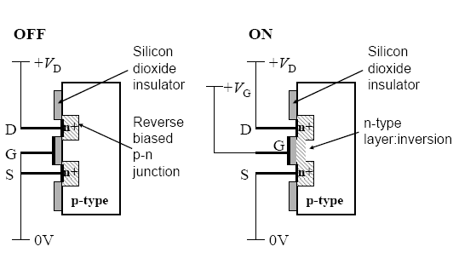
n-Channel MOSFET

Slide 66



NMOS Structure
MOS (Metal-Oxide-Semiconductor) Nowadays gate is made of poly-silicon
􀂉 Channel length L and width W
􀁺 In most digital design, L is set at the minimum feature size
􀁺 W is selectable by the designer
􀂉 Bulk is connected to the Gnd in NMOS to prevent forward-biased PN junction
On state
Off state

Slide 67

n-MOSFET Characteristics
Plots V-I characteristics
of the device for various
Gate voltages (VGS)
At a constant value of VDS , we can
also see that IDS is a function of the
Gate voltage, VGS
The transistor begins to conduct
when the Gate voltage, VGS , reaches
the Threshold voltage: VT

Slide 68



PMOS Structure
PMOS transistor has a negative threshold voltage (Vtp) -0.3v~-1.2v
A pMOS turns on when Vgs<Vtp

Slide 69

P-MOSFET Characteristics
The terminal characteristics of the device are given by drain-to-source current Ids against drain-to-source voltage Vds for different values of gate-to-source voltage Vgs. All voltages are referenced with respect to the source voltage, which is assumed to be at ground potential.

Slide 70
Pinch off?
V_{G}
V_{G}
V_{G}
V_{G}
0
0
0
0
0
V_{D}
Now add in the drain voltage to drive a current. Initially you get an increasing current with increasing drain bias
When you reach V_{Dsat} = V_{G} – V_{T}, inversion is disabled at the drain end (pinch-off), but the source end is still inverted
The charges still flow, just that you can’t draw more current
with higher drain bias, and the current saturates

Slide 71
CMOS Working Principle and Applications
The term CMOS stands for “Complementary Metal Oxide Semiconductor”. CMOS technology is one of the most popular technology in the computer chip design industry and broadly used today to form integrated circuits in numerous and varied applications.
Today’s computer memories, CPUs and cell phones make use of this technology due to several key advantages. This technology makes use of both P channel and N channel semiconductor devices. One of the most popular MOSFET technologies available today is the Complementary MOS or CMOS technology. This is the dominant semiconductor technology for microprocessors, microcontroller chips, memories like RAM, ROM, EEPROM and application specific integrated circuits (ASICs).
CMOS (Complementary Metal Oxide Semiconductor) The main advantage of CMOS over NMOS and BIPOLAR technology is the much smaller power dissipation. Unlike NMOS or BIPOLAR circuits, a Complementary MOS circuit has almost no static power dissipation. Power is only dissipated in case the circuit actually switches. This allows integrating more CMOS gates on an IC than in NMOS or bipolar technology, resulting in much better performance. Complementary Metal Oxide Semiconductor transistor consists of P-channel MOS (PMOS) and N-channel MOS (NMOS). Please refer the link to know more about the fabrication process of CMOS transistor

Slide 72

CMOS (Complementary Metal Oxide Semiconductor) The main advantage of CMOS over NMOS and BIPOLAR technology is the much smaller power dissipation. Unlike NMOS or BIPOLAR circuits, a Complementary MOS circuit has almost no static power dissipation. Power is only dissipated in case the circuit actually switches. This allows integrating more CMOS gates on an IC than in NMOS or bipolar technology, resulting in much better performance. Complementary Metal Oxide Semiconductor transistor consists of P-channel MOS (PMOS) and N-channel MOS (NMOS).

Slide 73

NMOS is built on a p-type substrate with n-type source and drain diffused on it. In NMOS, the majority carriers are electrons. When a high voltage is applied to the gate, the NMOS will conduct. Similarly, when a low voltage is applied to the gate, NMOS will not conduct. NMOS are considered to be faster than PMOS, since the carriers in NMOS, which are electrons, travel twice as fast as the holes.
PMOS consists P-type Source and Drain diffused on an N-type substrate. Majority carriers are holes. When a high voltage is applied to the gate, the PMOS will not conduct. When a low voltage is applied to the gate, the PMOS will conduct. The PMOS devices are more immune to noise than NMOS devices.

Slide 74





















CMOS
Complementary CMOS logic gates
  pMOS pull-up network
  nMOS pull-down network
  a.k.a. static CMOS
pMOS
pull-up
network
inputs
output
nMOS
pull-down network
 | Pull-up OFF | Pull-up ON
Pull-down OFF | Z (float) | 1
Pull-down ON | 0 | X (crowbar)

Slide 75
In CMOS technology, both N-type and P-type transistors are used to design logic functions. The same signal which turns ON a transistor of one type is used to turn OFF a transistor of the other type.
This characteristic allows the design of logic devices using only simple switches, without the need for a pullup resistor. In CMOS logic gates a collection of n-type MOSFETs is arranged in a pull-down network between the output and the low voltage power supply rail (Vss or quite often ground).
Instead of the load resistor of NMOS logic gates, CMOS logic gates have a collection of p-type MOSFETs in a pull-up network between the output and the higher-voltage rail (often named V). Thus, if both a p-type and n-type transistor have their gates connected to the same input, the ptype MOSFET will be ON when the n-type MOSFET is OFF, and vice-versa. T

Slide 76

To build a logic gate we need to build two switch networks:

Slide 77
CMOS NOT
TRUTH TABLE
A Y
0 1
1 0
^{V}DD
A
A
Y
A
Y
GND

Slide 78
^{V}DD
CMOS Inverter
TRUTH TABLE
A Y
0
1 0
OFF
A=1
Y=0
ON
A
Y
GND
CMOS Digital Integrated Circuit
Unit 1

Slide 79
^{V}DD
CMOS Inverter
TRUTH TABLE
A Y
0 1
1 0
ON
A=0
Y=1
OFF
A
Y
GND
CMOS Digital Integrated Circuit
Unit 1

Slide 80



CMOS Inverter
A simplified model of the inverter for a high input level. The output is forced to zero through the on- resistance of the NMOS transistor.
Simplified model of the inverter for low input level. The output is pulled to VDD through the on- resistance of the PMOS transistor.
A CMOS inverter uses one NMOS and one PMOS transistor.

Slide 81

Rule of Conduction Complements
First Design Pull Down Network (PDN)
Then Pull-up network is complement of pull-down
parallel → series, series → parallel
Series nMOS: Y=0 when both inputs are 1
Thus Y=1 when either input is 0
Requires parallel pMOS
.

Slide 82

CMOS NAND Gate Design
A 2-input CMOS NAND gate
.
CMOS Digital Integrated Circuit
Unit 1

Slide 83

PUN and PDN CONSTRUCTION

Slide 84

CMOS NOR Gate Design
A 2-input CMOS NOR gate
CMOS Digital Integrated Circuit
Unit 1

Slide 85

CMOS NOR Gate Design
Work out the values for both the push and pull networks
Compare them
What is the result?

Slide 86

PUN and PDN CONSTRUCTION

